Slide 1

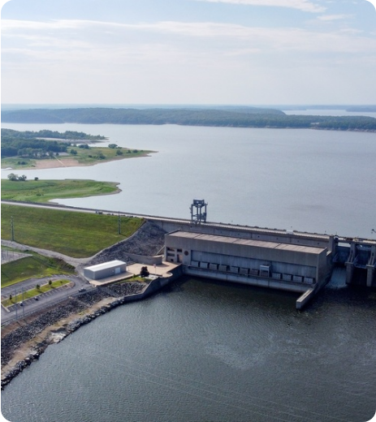
EMBEDDED IOT & TELEMETRY SYSTEM
ESP32 Smart Water Dam Monitoring & Control
Dual-sensor flood interlock, GSM SMS gate automation, EEPROM storage, and real-time voice-enabled web dashboard.

Slide 2
01 / PROJECT MOTIVATION
Why Dual-Sensor Dam Automation?
Single-Sensor Risks
Our ESP32 Architecture
False Echoes: Floating debris distorts ultrasonic readings.
AND-Gate Interlock: Requires both sensors to confirm flood.
Switch Tampering: Accidental float movement triggers panic.
Single-Shot SMS Lock: Dispatches exactly one SMS per event.
SMS Flooding: Unlatched code spams hundreds of alerts.
Two-Way Gate Control: Open or close relay via SMS or GUI.
Power Loss Reset: Volatile RAM loses saved phone numbers.
Flash EEPROM Storage: Retains settings across power cycles.

Slide 3

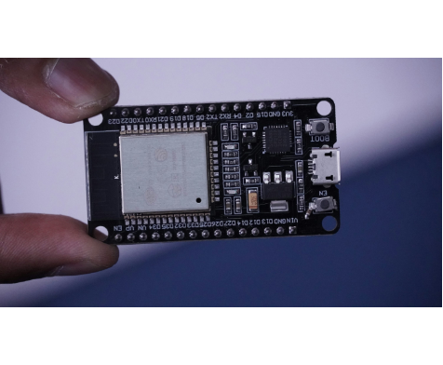
02 / HARDWARE ARCHITECTURE
Central ESP32 Processing Hub
1. Dual Input Sensing Layer
HC-SR04 Ultrasonic measures continuous height; side Float Switch detects high-water contact.
2. Local & Cellular Communication
2.4GHz Wi-Fi hosts the Web GUI on mobile hotspot; UART2 drives SIM800L GSM module.
3. Physical Actuation & Display
16x2 I2C LCD displays real-time telemetry; GPIO 33 Relay operates the spillway gate.

Slide 4
03 / WIRING SPECIFICATION
ESP32 Hardware Pinout Mapping
Hardware Module | Signal Pin | ESP32 GPIO | Electrical Configuration
HC-SR04 Ultrasonic | TRIG / ECHO | GPIO 26 / GPIO 27 | 10us pulse trigger; 30ms echo timeout
Side Float Sensor | 2-Wire Reed Switch | GPIO 25 & GND | INPUT_PULLUP (Active HIGH when floating)
Spillway Gate Relay | IN Control Pin | GPIO 33 | Optocoupler Active-LOW output
Alert Piezo Buzzer | Positive (+) | GPIO 14 | 250ms non-blocking pulse timer
SIM800L / GSM Module | TXD / RXD | GPIO 16 / GPIO 17 | Hardware UART2 at 9600 bps
16x2 I2C LCD Display | SDA / SCL | GPIO 21 / GPIO 22 | I2C Address 0x27 (5V VCC)

Slide 5

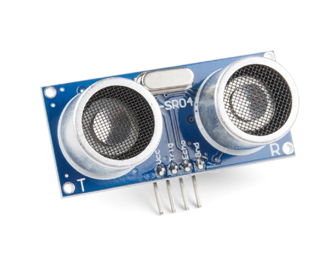


04 / WATER LEVEL SENSING
Ultrasonic Distance-to-Percentage Math
Mounted at the top of the dam, the HC-SR04 emits a 40 kHz acoustic pulse and measures time-of-flight to the water surface:
Total dam depth (H_dam) is user-configurable via the Web GUI and stored in EEPROM.

Slide 6



05 / CORE SAFETY LOGIC
Dual-Sensor Interlock Truth States
1. Normal Safe
2. False Float Blocked
3. Pre-Alert Standby
4. Confirmed Critical
Level below 80% threshold.
Float HIGH ignored below threshold.
Level above 80% awaiting float.
Both active triggers full alarm.

Slide 7
06 / FIRMWARE EXECUTION FLOW
500ms Non-Blocking Control Loop
STEP 01
Boot & Restore EEPROM Settings
Loads saved phone number, dam depth, warning threshold, and relay gate state.
STEP 02
Sample Ultrasonic & Side Float Switch
Computes fill percentage and checks if GPIO 25 reed switch is HIGH.
STEP 03
Evaluate Dual-Confirmation Interlock
When Level >= Threshold AND Float == HIGH, dispatches 1 SMS and pulses buzzer.
STEP 04
Refresh 16x2 LCD & Serve Web GUI JSON
Streams live telemetry to browser every second and listens for SMS gate commands.

Slide 8

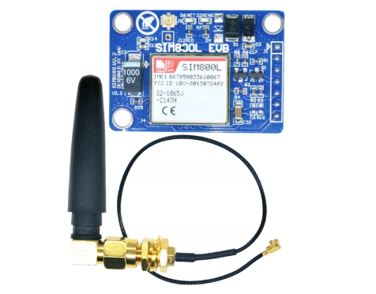
07 / CELLULAR TELEMETRY
Two-Way GSM SMS Alert & Relay Control
Signal Monitoring: Polls AT+CSQ every 10s and maps RSSI (0–31) to 0–100%.
Single-Shot Alert: Sends one emergency SMS to the EEPROM-saved mobile number upon confirmed flood.
Remote Gate Open: Texting GATE ON energizes GPIO 33 relay and replies with confirmation.
Remote Gate Close: Texting GATE OFF closes the spillway gate remotely.

Slide 9
08 / INTERACTIVE WEB DASHBOARD
Hotspot GUI & Smooth Ladies Voice Announcer
Animated Dam Cross-Section
Smooth Female Speech Synthesis
Visualizes rising reservoir water, ultrasonic beam, side float state, and spillway gate.
Selects Indian/UK female voice at 100% volume, 0.92x smooth rate, and 1.12 pitch.
Dual-Tone Siren Pre-Chime
Instant Gate & EEPROM Controls
Plays an 880Hz–1174Hz Web Audio chime before every spoken emergency announcement.
One-tap OPEN/CLOSE relay buttons and live form to update saved SMS phone number.

Slide 10
09 / DATA PERSISTENCE & LOCAL DISPLAY
Flash EEPROM Storage & 16x2 LCD Readout
Saved Phone Number
Depth & Threshold
16x2 I2C LCD Format
Stored under NVS key "phone".
Retains custom tank calibration after reboot.
Lvl: 84% Sig:77%
Flt:HI Gate:OPEN

Slide 11
10 / SYSTEM BENCHMARKS
Real-Time Operational Specifications
500ms
2x
100%
1s
Sensor Sampling Interval
Fault-Tolerant Sensor Interlock
EEPROM Setting Retention
Web GUI Live Refresh Rate

Slide 12
PROJECT DEMONSTRATION & SUMMARY
Thank You & Questions
ESP32 Dual-Sensor Dam Monitoring with GSM SMS Automation, Flash EEPROM Persistence, and Voice-Enabled Web GUI.

Slide 13




Image Sources
https://d1ldvf68ux039x.cloudfront.net/thumbs/photos/2501/8838433/1000w_q95.jpg
Source: www.dvidshub.net
https://images.unsplash.com/photo-1649559295229-961cbad5d13f?fm=jpg&q=60&w=3000&auto=format&fit=crop&ixlib=rb-4.1.0&ixid=NHwxMjA3fDA%3D
Source: unsplash.com
https://www.sparkfun.com/media/catalog/product/cache/f8158826193ba5faa8b862a9bd1eb9e9/1/5/15569-Ultrasonic_Distance_Sensor_-_HC-SR04-01a.jpg
Source: www.sparkfun.com
https://probots.co.in/pub/media/catalog/product/cache/d8ddd0f9b0cd008b57085cd218b48832/s/i/sim800l_v2.0_5v_wireless_gsm_gprs_module_quad-band_with_antenna_5_.jpg
Source: probots.co.in

